Slide 1

State Of Charge
Voltage over time for a discharging battery

Slide 2
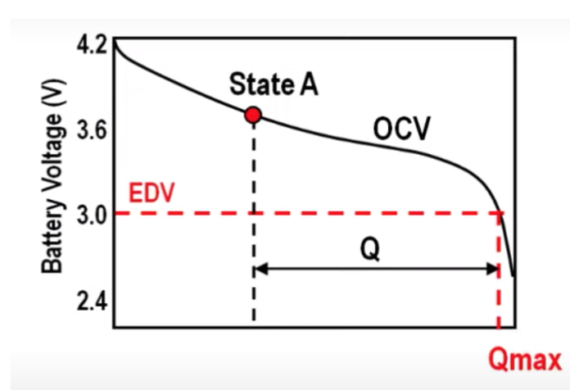
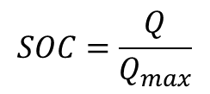
What is the State of Charge?
The state of charge refers to the ratio of charge remaining to the total charge capacity.
As the battery is discharged, the voltage produced by the battery changes
$$SOC=\frac{Q}{Q_{max}}$$
SOC = 1 (DOD = 0) for fully charged battery
SOC = 0 (DOD = 1) for fully discharged battery

Slide 3
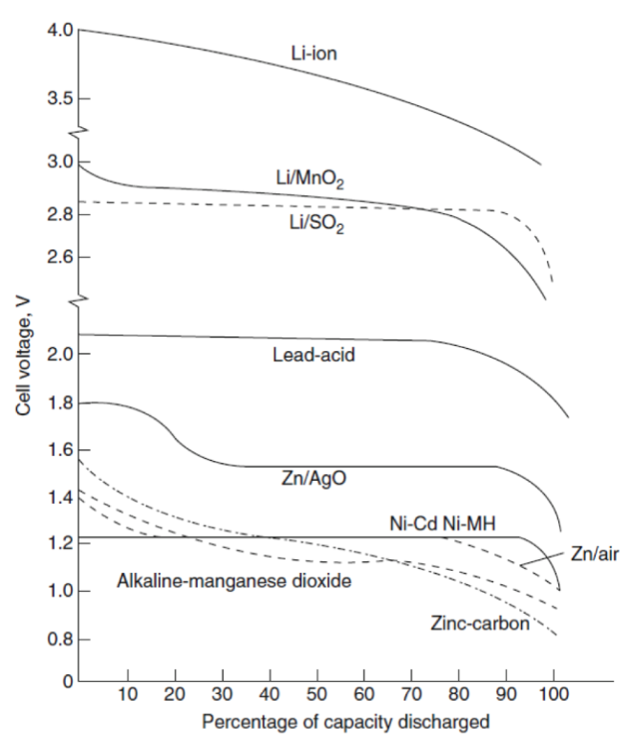
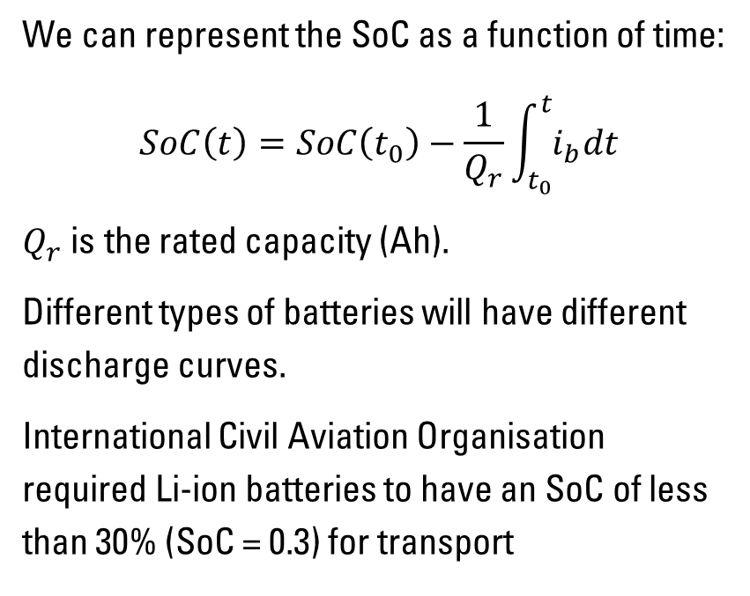
Discharge Curves
We can represent the SoC as a function of time:
$$SoC\left(t\right)=SoC\left(t_{0}\right)−\frac{1}{Q_{r}}\int_{t_{0}}^{t}{i_{b}dt}$$
$Q_{r}$ is the rated capacity (Ah).
Different types of batteries will have different discharge curves.
International Civil Aviation Organisation required Li-ion batteries to have an SoC of less than 30% (SoC = 0.3) for transport

Slide 4
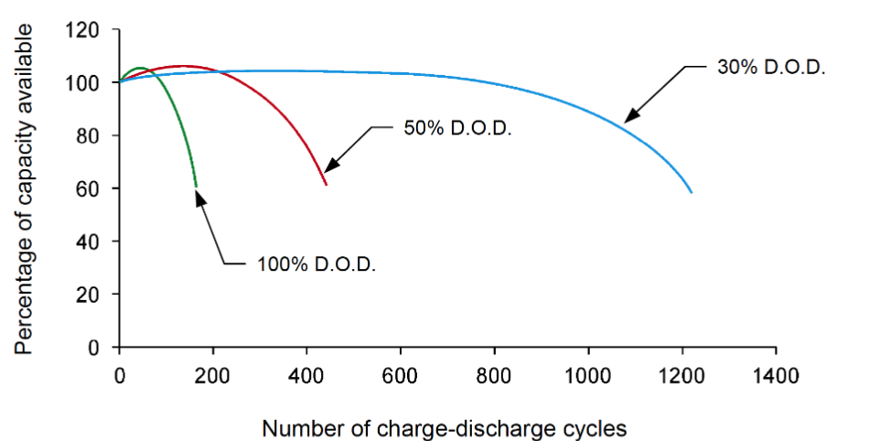
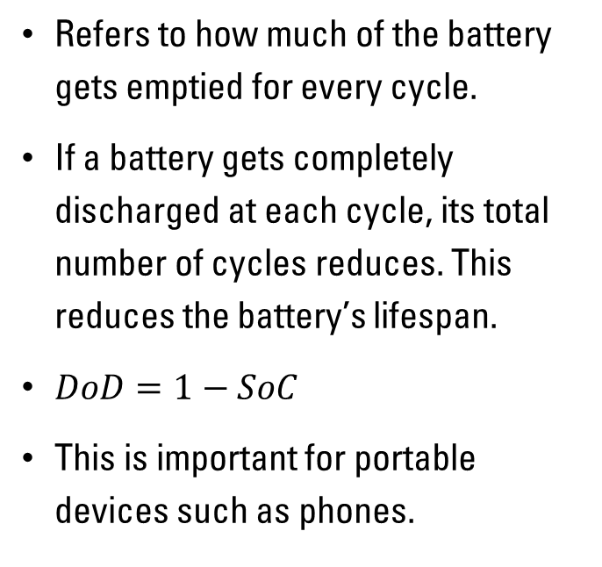
Depth of Discharge (DoD)
Refers to how much of the battery gets emptied for every cycle.
If a battery gets completely discharged at each cycle, its total number of cycles reduces. This reduces the battery’s lifespan.
$DoD=1−SoC$
This is important for portable devices such as phones.

